Slide 1

IDFC FIRST BANK Case Study
Presented by:
Name: Raj Karan Kumar
Roll No.: 190674

Slide 2

Problem Statement:
To help the Bank prioritize its Credit Card transactions for EMI calling
To get insights from the given dataset for helpful suggestions

Slide 3
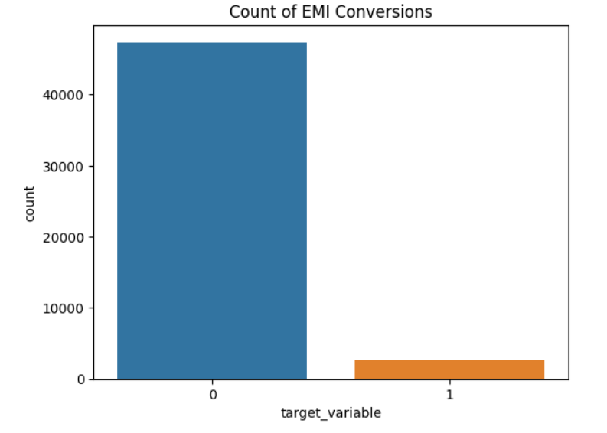
Data Analysis:
Dataset comprised of 50,000 credit card transactions
The columns comprised of transaction attributes, card attributes, previous history on the Card, savings account attributes & bureau attributes
Exploratory data analysis on the provided data was done which gave certain insights
The dataset given was unbalanced
Ratio between the number of positive and negative samples was looked at for analysis

Slide 4
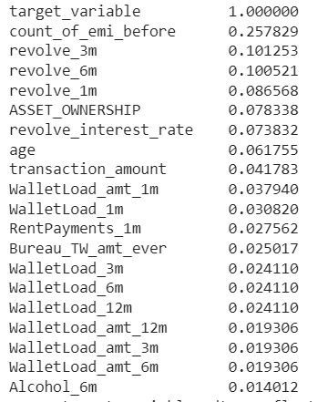
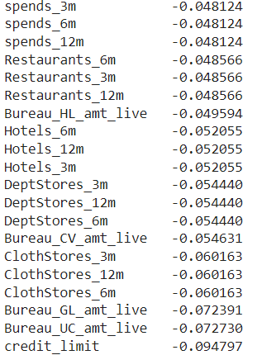
Relation of various features to EMI Conversions
Looked for the correlation of various features with the target variable
Positive Correlations
Negative Correlations

Slide 5

Insights from the correlation
count_of_emi_before has the highest positive correlation
revolve_1m has the second highest positive correlation
"Revolve" refers to the practice of carrying a balance on a credit card from one month to the next, instead of paying off the full balance
credit_limit has the highest negative correlation
Bureau_UC_amt_live has the second highest negative correlation
The bureau amount live is the current amount of debt that the cardholder has on their credit card account, which has not yet been paid off or settled.

Slide 6
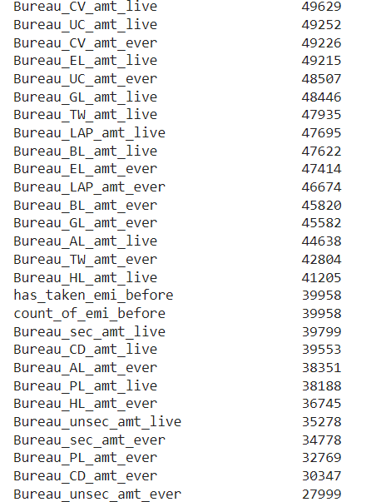
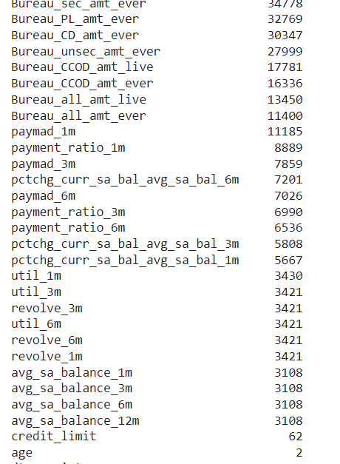
Handling the missing values
These are all the columns name with the count of all the NULL values

Slide 7

Insights from the NULL values count
As most of the columns containing “Bureau” has a lot of null values, hence we can drop these columns
In these columns we can’t predict the value for the NA values as it is improbable to predict a correct loan
paymad, payment_ratio, pctchg_curr_sa_bal_avg_sa_bal, util, credit_limit, avg_sa_balance columns; null values should be filled with the mean value
Other columns NA values can be filled with 0
NA values in count_of_emi_before and has_taken_emi_before is high but they have high correlation

Slide 8
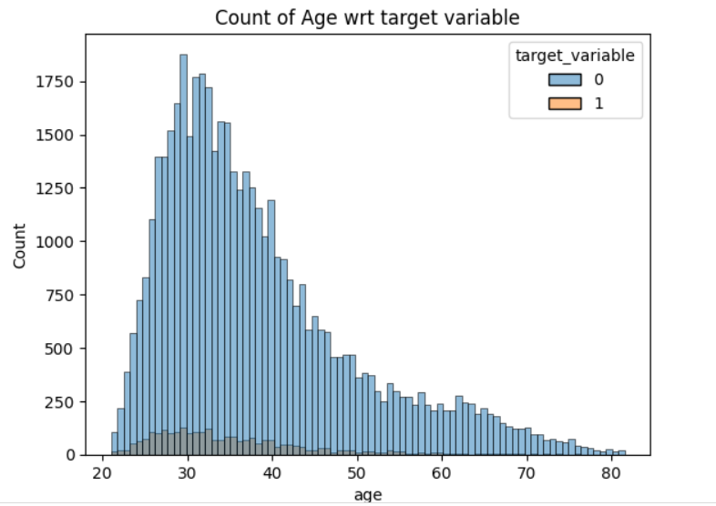
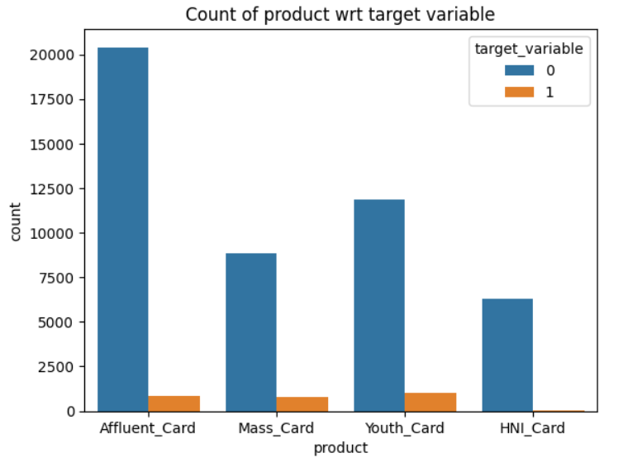
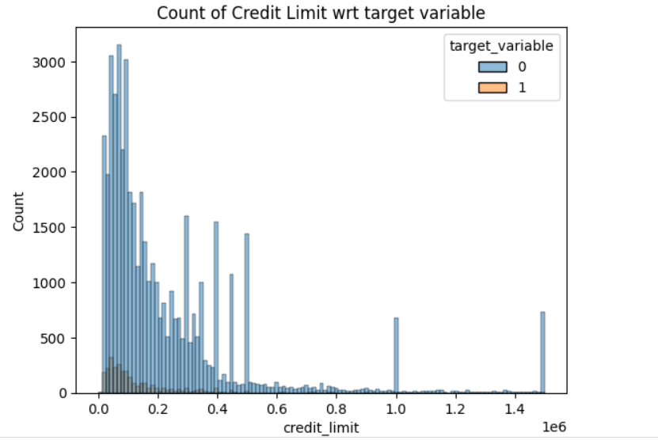
Some Relational Graphs

Slide 9

Some Inferences from the Relational Graphs
Person in the age group of 20-40 opt for the positive EMI conversion
In different types of cards ‘Mass Card’ ,‘Youth Card’ has higher values of EMI conversion
Much Higher Credit Limit value has less chance of EMI Conversion

Slide 10
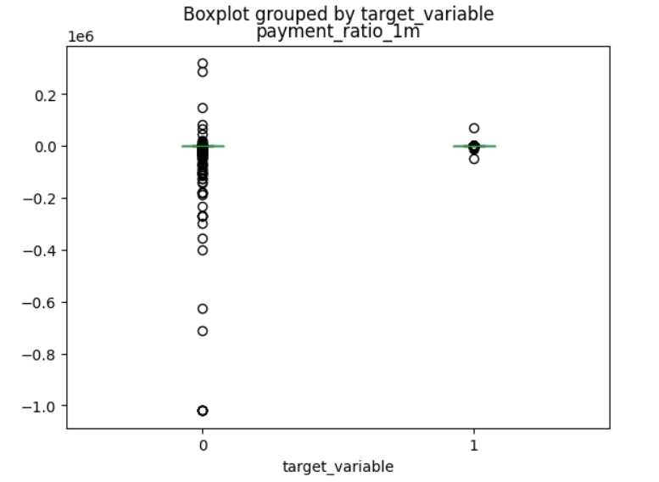
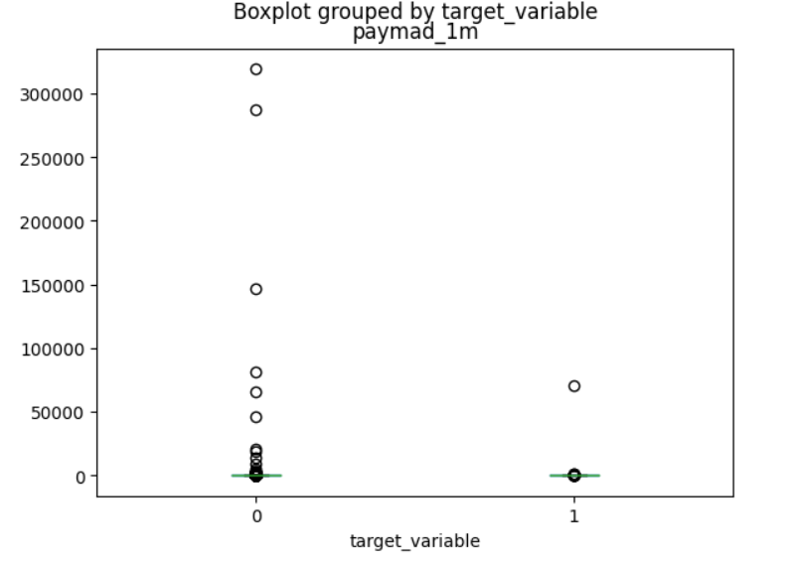
Data Pre-Processing/ Feature Extraction
Dropped some of the categorical columns such as merchant_name, merchant_country
Performed one hot encoding to convert categorical data to numerical data
Filled the null values with zero in some column, with mean in some columns as required
Did Z-Score data normalization by excluding the outliers

Slide 11
Training ML Models
Case 1: Without dropping any columns and without normalization
Case 2: Dropping some of the columns ,with normalization
Case 3: Dropping some of the columns, with normalization and taking effect of outliers

Slide 12
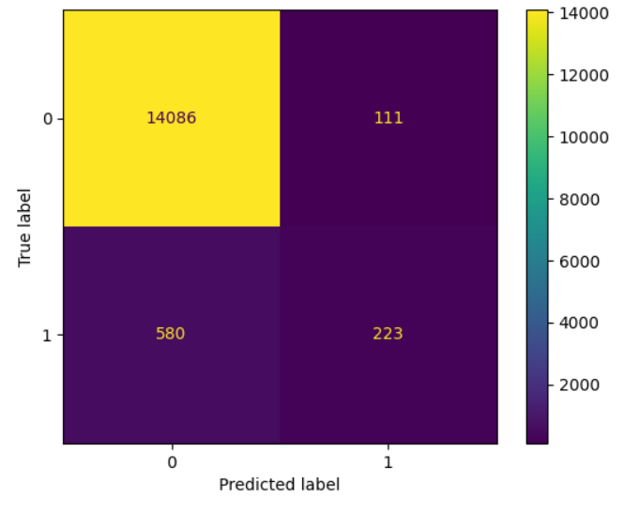
Performance of ML Models in case 1
Trained our model on various algorithms such as Logistic Regression, Random Forest Classifier, Adaboost, ANN and Xgboost
ML Model | Accuracy
Logistic Regression | 94.69%
Random Forest | 95.33%
Adaboost | 94.68%
ANN | 94.72%
Xgboost | 95.39%

Slide 13
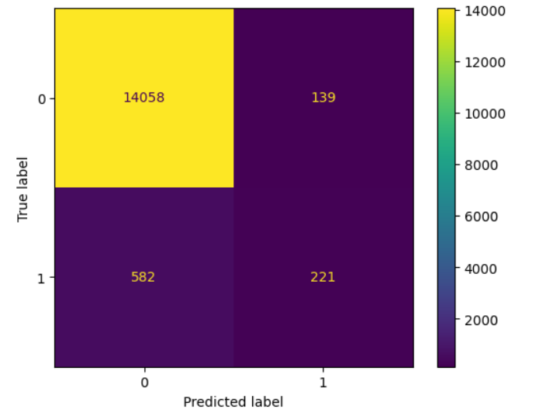
Performance ML Models in case 2
After dropping some columns and normalizing the data, performance of ML models are as follows:
ML Models | Accuracy
Logistic Regression | 94.66%
Random Forest | 95.28%
Adaboost | 94.79%
ANN | 94.81%
Xgboost | 95.28%

Slide 14
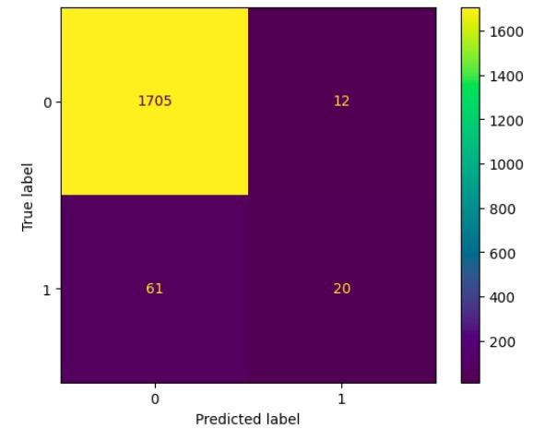
Performance of ML Models in case 3
After dropping some columns and normalizing the data and considering outliers also performance of ML models are as follow:
ML model | Accuracy
Logistic Regression | 95.33%
Random Forest | 95.49%
Adaboost | 95.22%
ANN | 95.11%
Xgboost | 95.94%

Slide 15

Scope of Improvement
Can fine- tune ANN model by experimenting with number of layers, neurons & other hyper-parameters
Since the dataset is unbalanced, we can try to oversample the minority class and undersample the majority class
Can try other ways to fill NaN values like filling with median/mode or using linear interpolation
Can try different normalization techniques like Min-Max Normalization & Median and inter-quartile range normalization
Can do Hyperparameter Optimization for Xgboost

Slide 16

Recommendations & Results
XGBoost was the best classifier with an accuracy of almost 96%
Significant reduction in the cost of EMI calling
People who have takens loans like Bureau House Loan, Gold Loan, Commercial Vehicle Loan etc. would most likely not take EMI transactions
More data in the Bureau fields would be beneficial
More issue of Mass Card, Youth Card would lead to greater EMI conversions
More calls should be done to persons of age group 20-40
Features like count_of_emi_before, revolve_1m, credit_limit are of most importance

Slide 17

THANK YOU

